Slide 1
Introduction to SIEM
SIEM Day 1
1

Slide 2

Class Objectives
By the end of today’s class, you will be able to:
Analyze logs and determine the types of data they contain, as well as the types of security events they can help identify.
Isolate, identify, and correlate fields across raw log files.
Design a correlation rule to notify when an event occurs.
Make informed decisions about which SIEM vendor is best for an organization.
2

Slide 3

This week, we will move from offensive security to defensive security.
3
Notes:
Image source: shutterstock_1083618569

Slide 4

This Week...
Organizations must constantly determine whether the confidentiality, integrity, and availability of their data are being compromised.
For example
If an attacker were attempting to brute force their way into an an online auction company's admin website to steal information, the company would need to identify the activity before sensitive data and confidentiality were breached.
4
Notes:
shutterstock_1192408171

Slide 5

Over the next two weeks we will learn about SIEM (pronounced “sim”) technology, which organizations use to monitor and identify security incidents.
5
Notes:
shutterstock_1208815192

Slide 6


This Week...
You will play the role of a security operations center (SOC) manager at an online military products organization called Omni Military Products (OMP).
OMP recently experienced several security-related events that put their organization at risk.
As the new SOC manager, you will use SIEM tools and technologies to protect OMP from a variety of security events.
6
Notes:
shutterstock_719428999

Slide 7

While the next two weeks will be very hands-on, today will focus on conceptual understanding and the business decisions that companies must make to maintain the cybersecurity triad.
7
Notes:
shutterstock_1023890479

Slide 8
Introduction to Continuous Monitoring
8

Slide 9

As the new SOC manager, you will be tasked with using SIEM tools and technologies to protect OMP from a variety of security events.
(Source)
9
Notes:
https://dribbble.com/shots/8083198-Protect-your-data

Slide 10

Continuous monitoring, also known as information security continuous monitoring (ISCM), is the processes and technologies used to detect information security risks associated with an organization's operational environment in real time.
10

Slide 11



ISCM
ISCM provides real-time insight into the following:
The current state
of an organization’s networked assets.
Vulnerabilities
and threats that attack an organization’s networked assets.
Effectiveness
of security controls protecting an organization’s networked assets.
11
Notes:
Shutterstock_741528883 AdobeStock_290033459

Slide 12

ISCM
As we know, organizations face many different threats.
For example:
An employee can accidentally download malware onto their laptop, which can spread to an organization's network.
A script kiddie can launch a denial of service attack against a web server.
A nation state can attempt a code injection attack against an application.
12
Notes:
shutterstock_1389409868

Slide 13

Limiting ISCM
Organizations cannot protect against every single potential attack, as they may have:
Financial Limitations
Most modern monitoring tools and technologies are very expensive to install, deploy, and run. Organizations often have strict budgets that they have to maintain.
Staffing Limitations
While many monitoring tools have automated features, they often require humans to monitor and respond to detected issues.
13
Notes:
Shutterstock 1095422036

Slide 14

Due to these limitations, organizations need to make business decisions to prioritize the types of security risks they will monitor against.
14
Notes:
shutterstock_1280139850

Slide 15
Prioritizing Risks to Monitor
15

Slide 16


Prioritizing Risks
Organizations consider the following factors when determining how to prioritize security risks:
Compliance
Financial Impact
Reputational Impact
Likelihood of Attack
16
16

Slide 17


Prioritizing Risk
Compliance: Depending on the industry a business is in, it may be required to monitor and analyze certain application and system activity.
For example
For example, to remain PCI-compliant, financial businesses that work with credit cards may be required to monitor their applications that manage financial data.
17
Notes:
shutterstock_1608992503

Slide 18
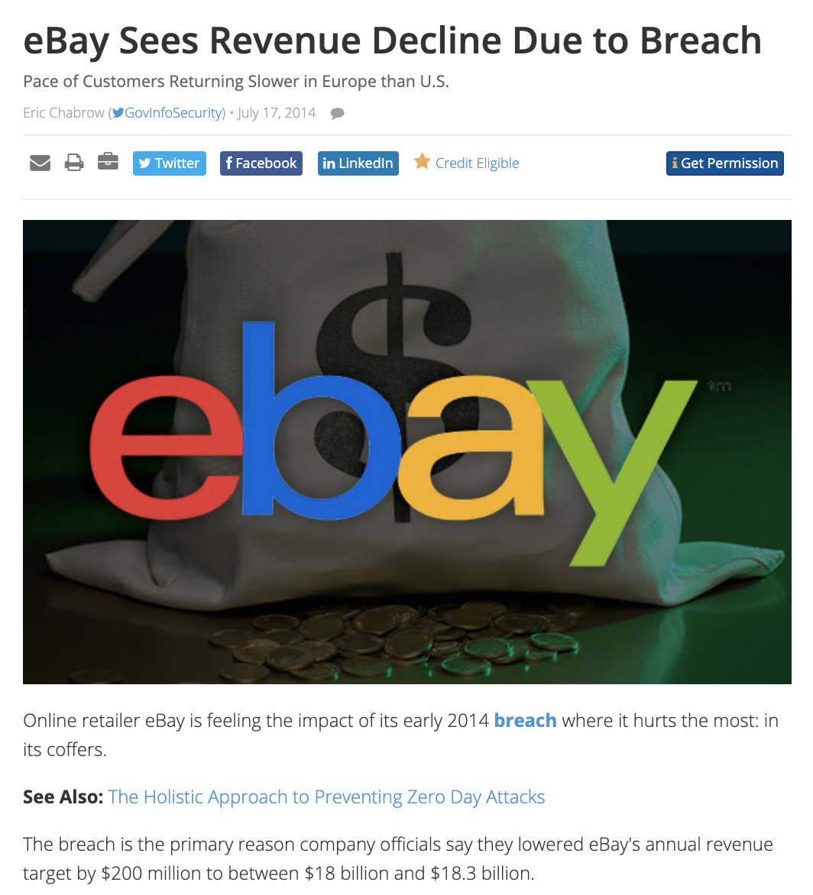
Prioritizing Risk
Financial impact: How a system breach or shutdown can impact the financial performance of an organization.
For example
A business like eBay would likely prioritize monitoring their customer-facing application. The cost of this being compromised and taken offline would significantly affect their revenue.
(Source)
18

Slide 19
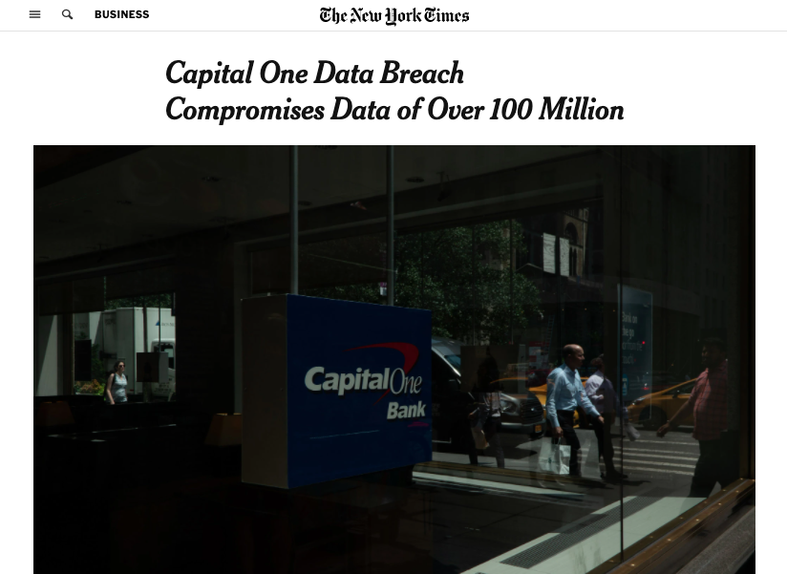
Prioritizing Risk
Reputational impact: How an incident would affect their reputation to customers.
For example
For example, an online banking provider would monitor their security controls of their customer financial data. If their customer data were breached, their reputation could be significantly affected.
(Source)
19

Slide 20
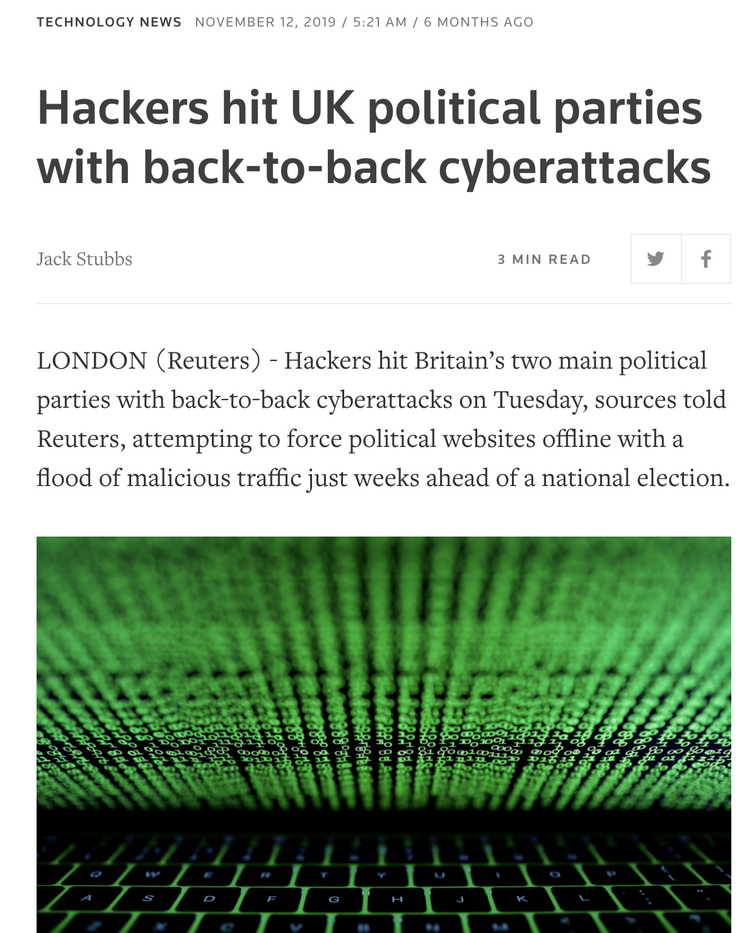
Prioritizing Risk
Likelihood of attack: While there are many types of security risks that can occur, some are more likely than others.
For example
For example, politically-associated businesses that have public-facing websites are particularly at risk of denial of service attacks. Given this higher likelihood, these organizations should prioritize monitoring for DOS attacks.
(Source)
20

Slide 21

Organizations must decide for themselves which factors to consider when prioritizing risks.
21
Notes:
shutterstock_668743333

Slide 22
Activity: Monitoring Your Assets
In this activity, you will analyze the types of security events and rank them based on risk to the organization.
7 Minutes
22

Slide 23
23

Slide 24
Logs, Logs, and more Logs
24

Slide 25
After organizations decide what kind of events they want to monitor, they need to decide how to monitor them.
25
Notes:
Image source: shutterstock_1083618569

Slide 26
Logs are the most common organizational method for monitoring. These are collections of entries that record individuals events occurring on a device or network.
26

Slide 27
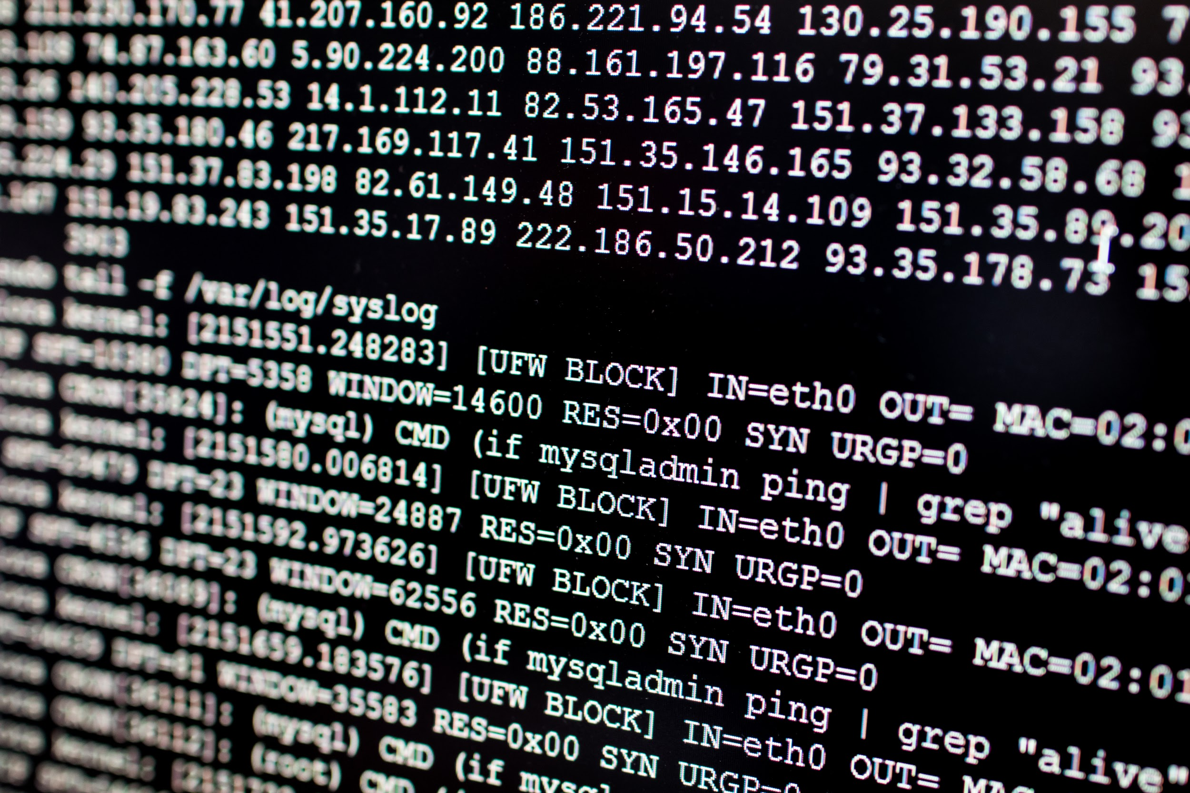
Logs
While log entries were originally designed to assist with troubleshooting system issues, they later proved useful to security professionals as a source of insight into:
01
The state of a device or a network.
02
Access to a device or a network.
03
User activities on a device or a network.
Notes:
shutterstock_625972751

Slide 28
Types of Logs
Due to the quantity of networking and security assets and devices, logs come from a variety of sources:
Operating system logs
Application logs
Networking device logs
Security device logs
28

Slide 29




Types of Logs
Operating system logs are created on devices such as Linux and Windows systems.
Security events that can be identified by these logs include:
Security access events
Such as an unauthorized user attempts to access privileged data, such as a company payroll file.
Security permissions events
Such as a user attempts to give themselves permissions to access and edit a privileged file.
29

Slide 30


Types of Logs
Application logs are created by devices such as Apache and IIS (Internet Information Services) servers.
Security events that can be identified by these logs include:
Application access events
Such as a brute force attempt to log into an administrative account on a web application.
Fraud events
Such as a user on a financial application attempting to transfer a large sum of funds to a suspicious external account.
30

Slide 31
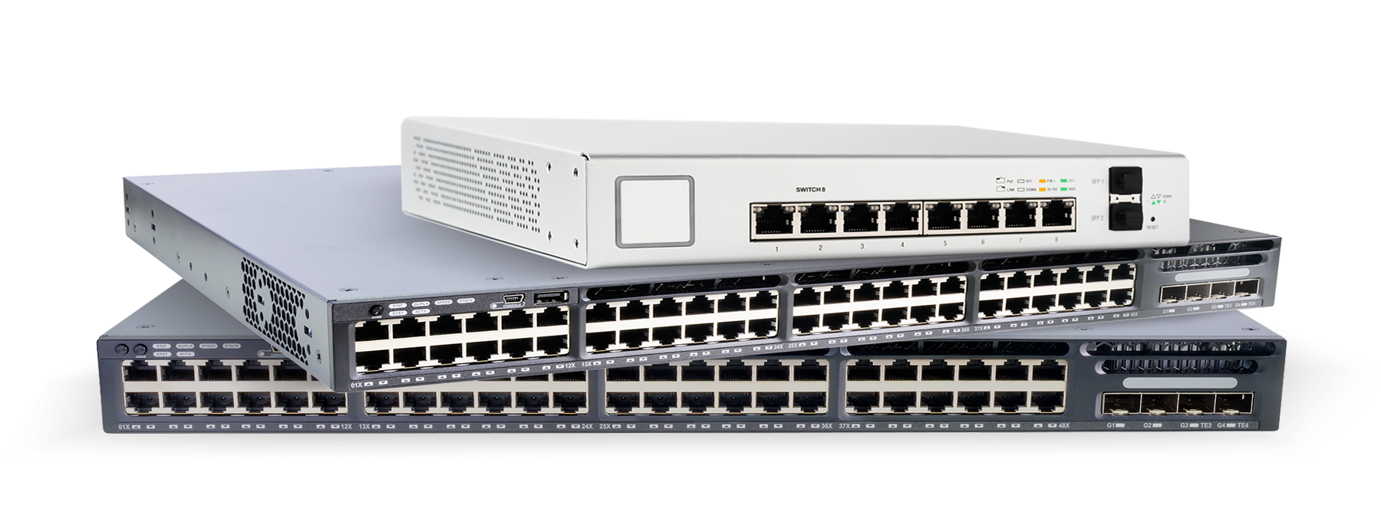
Types of Logs
Networking device logs are created on devices such as routers, switches, and DHCP/DNS servers.
Security events that can be identified by these logs include:
Administrative events
Such as a network administrator accidentally opening a port allowing unauthorized traffic into a network.
Network security events
Such as a DHCP starvation attack in which the DHCP server receives thousands of requests in a short period of time, consuming all available IP addresses.
31
Notes:
Image sources: AdobeStock_244465090 (top); shutterstock_264840719 (middle); shutterstock_291540545 (bottom);

Slide 32
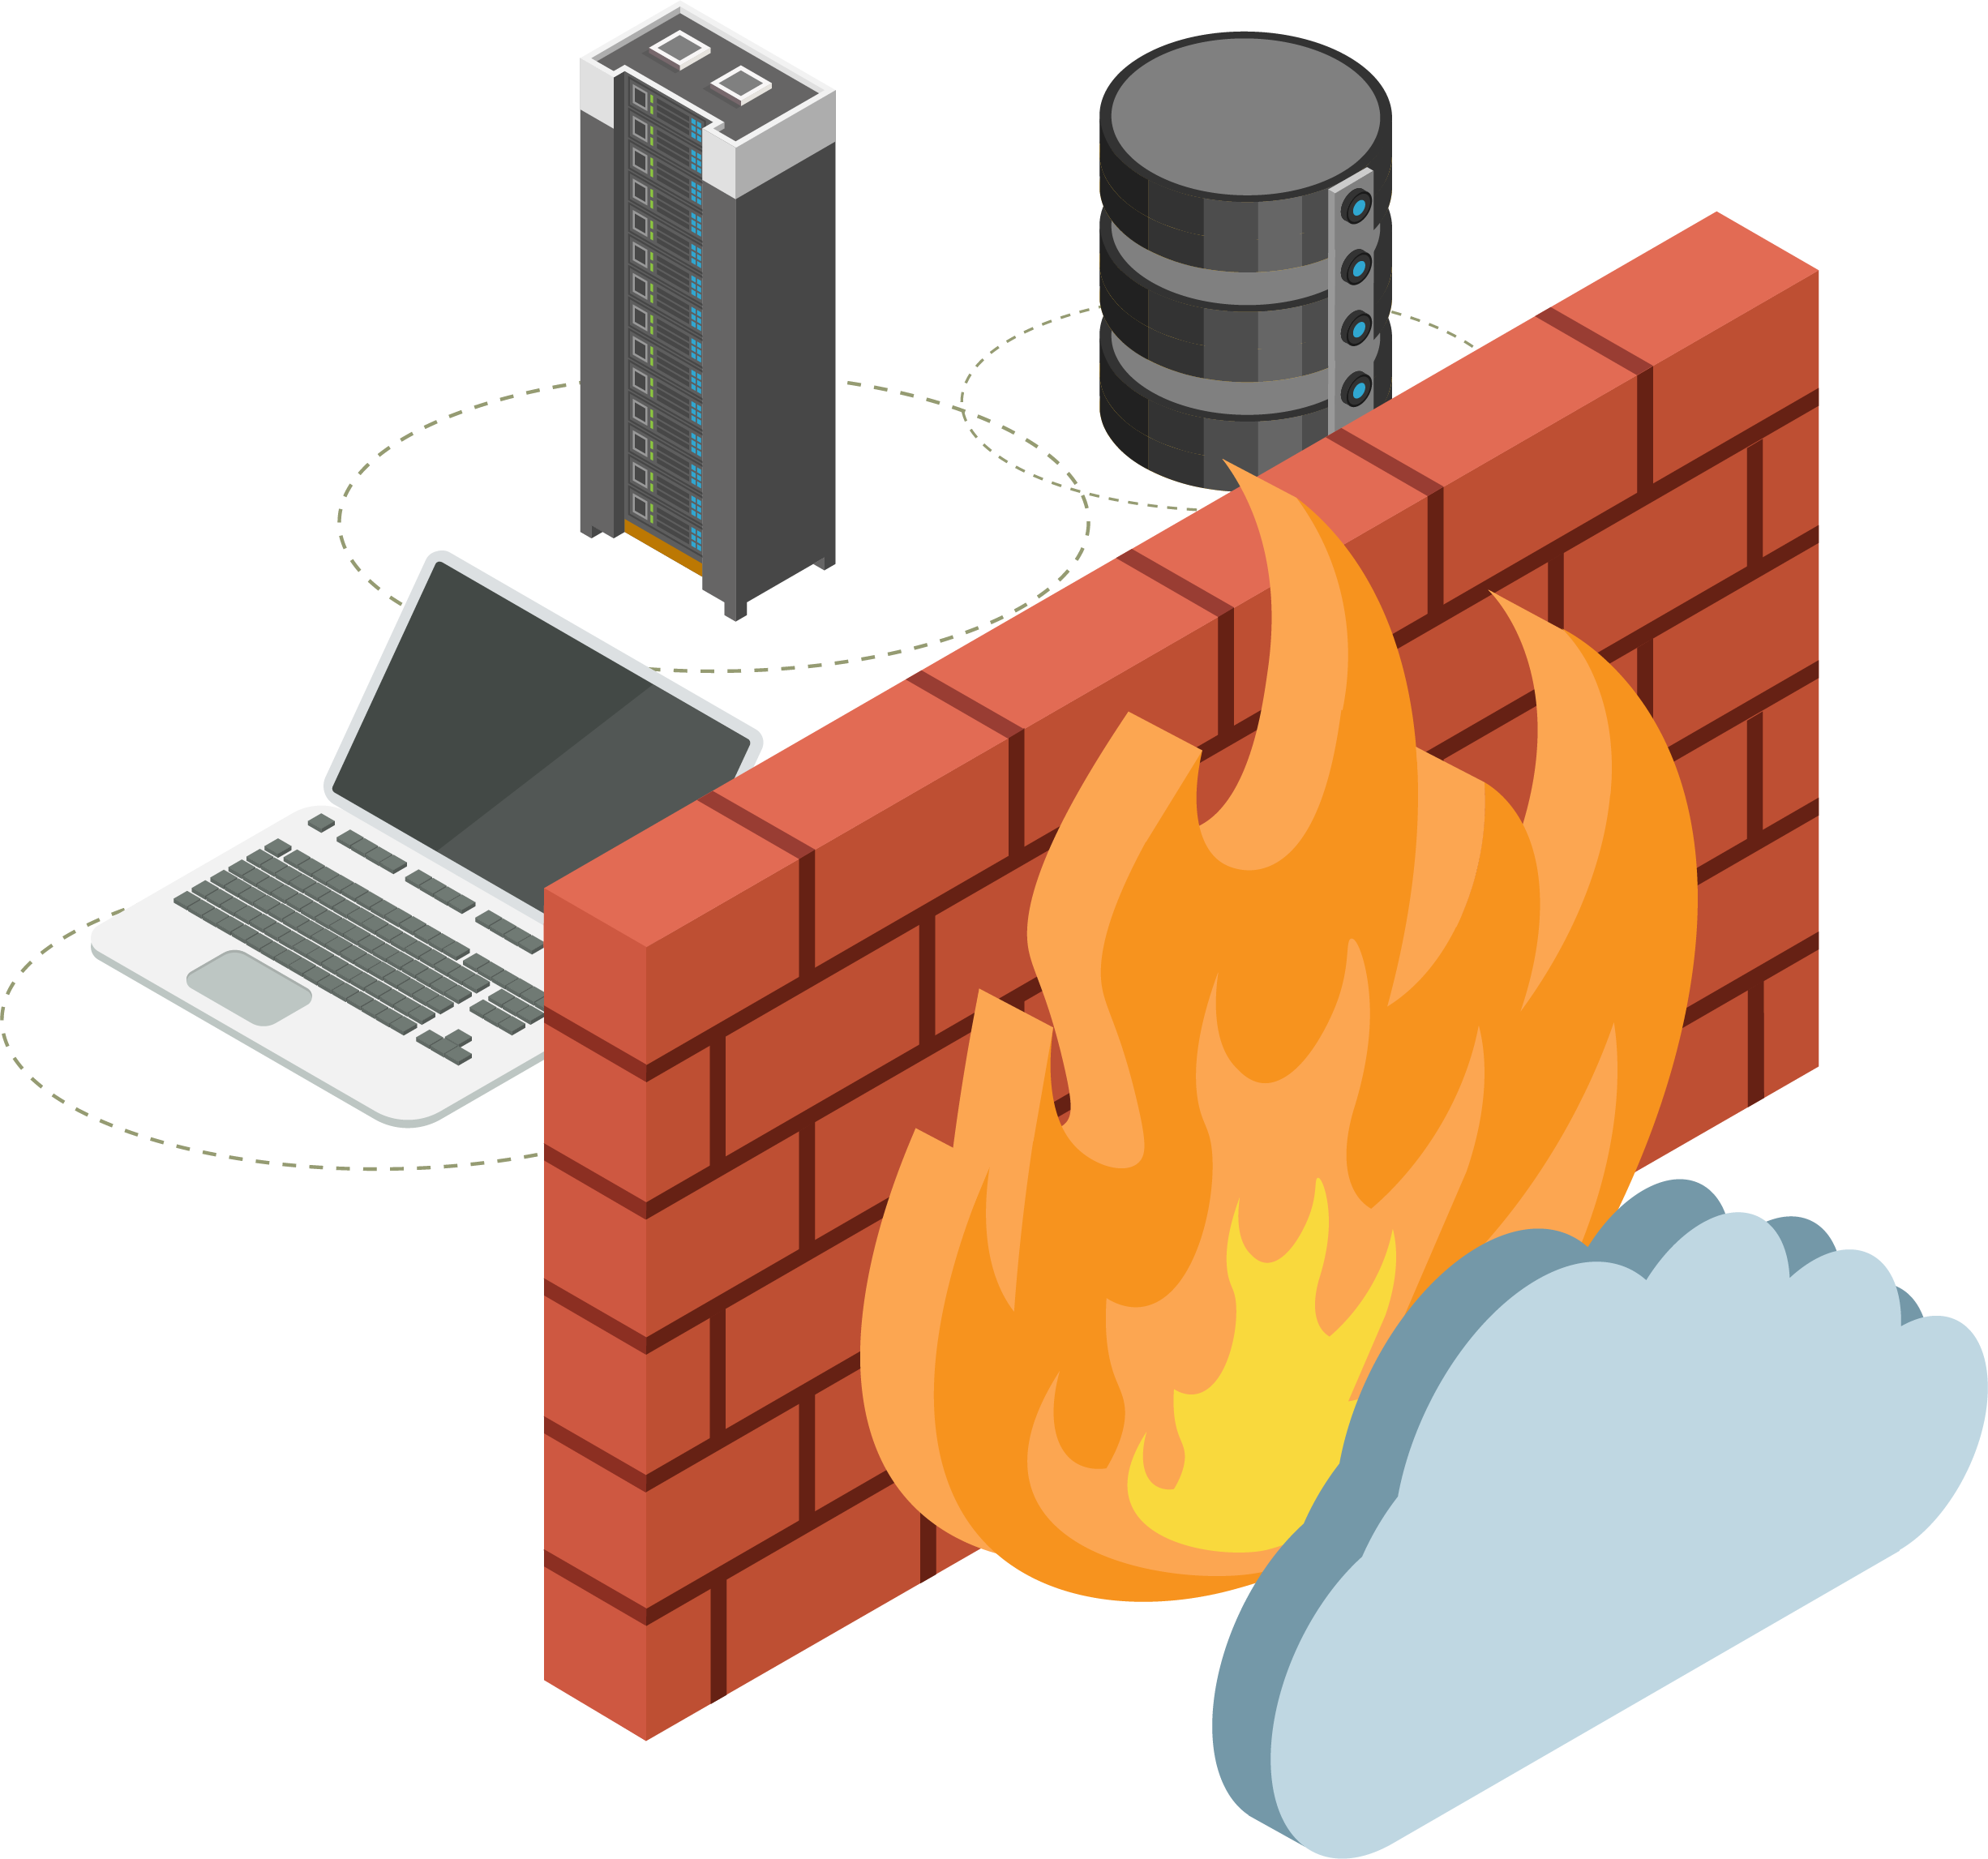
Types of Logs
Security device logs are created on devices such as IDS/IPS, firewalls, endpoint devices, and honeypots.
Security events that can be identified by these logs include:
Endpoint events
Such as a user accidentally downloading malware onto their laptop from a phishing email.
IDS signature events
Such as a packet with an illegal TCP flag combination being identified by an IDS.
32
Notes:
shutterstock_792833623

Slide 33
Logs
While this is not a complete list of all the possible logs that security professionals use, students should be familiar with these types of logs and the types of security events they can help identify.
Notes:
shutterstock_625972751

Slide 34
Activity: What is this Log?
In this activity, you will analyze and categorize various log types.
7 Minutes
34

Slide 35
35

Slide 36

36
Notes:
Image source: AdobeStock_56885471
Break

Slide 37
Log Aggregation and Normalization
37

Slide 38
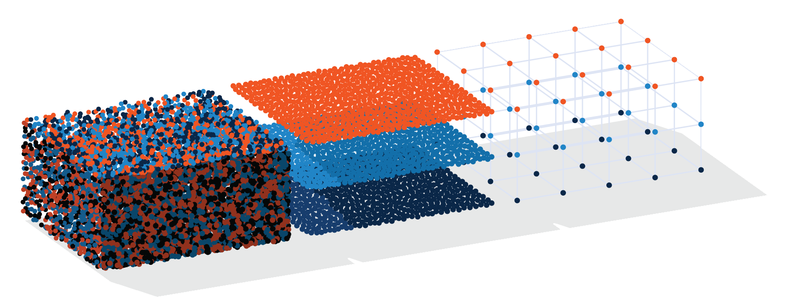
Whole Lotta Logs
The amount of incoming logs from various sources can be overwhelming.
For example
if a business wants to monitor suspicious logins on their Linux servers, they may have to monitor a variety of Linux servers and distributions.
They’d want to identify all the Linux server logs they have available and aggregate them into a single destination and format.
38

Slide 39
Log aggregation is the identification and collection of logs from multiple computing sources.
39

Slide 40
Log Aggregation
Logs from different sources, even if they are logging similar data, are often created in different formats.
User TJones Successfully Authenticated to 10.182.12.35 from client 43.10.8.22
Log 1:
Log 2:
43.182.12.35 New Client Connection 84.10.8.22 on account: PSmith: Success
40

Slide 41
Log Parsing
Log parsing is the process of converting the single string of data and into structured data.
User | TJones | Successfully Authenticated | to | 10.182.12.35 | from client | 43.10.8.22
Log 1:
Log 2:
43.182.12.35 | New Client Connection | 84.10.8.22 | on account: | PSmith | : Success
By separating the values, each field can be categorized and rearranged to match a uniform structure.
41

Slide 42
Log Normalization
Log normalization is the process of standardizing fields in data from different sources and formats so it can be analyzed together.
Key:
User
Destination IP
Source IP
Log 1:
User TJones Successfully Authenticated to 10.182.12.35 from client 43.10.8.22
Log 2:
43.182.12.35 New Client Connection 84.10.8.22 on account: PSmith: Success
42

Slide 43
Activity: Log Aggregation and Normalization
In this activity, you will aggregate and normalize various logs by identifying the fields contained within the log files.
7 Minutes
43

Slide 44
44

Slide 45
Log Correlation
45

Slide 46
Log Correlation
We can use log correlation to detect security events.
Individual log entries often do not indicate security events alone.
Analyzing multiple log entries together can help us detect security events and patterns of suspicious behavior.
Log correlation connects multiple log entries to make raw data into useful information.
Different log entries can come from the same source or different sources.
46

Slide 47
Log Correlation
While this single entry may not seem suspicious...
[10/12/2019 04:32:03 PM] 41.34.54.233 user=testerA "Login Failed"
47

Slide 48
Log Correlation
The following log entries correlated together indicate a potentially suspicious security event, such as a brute force attack.
[10/12/2019 04:32:03 PM] 41.34.54.233 user=testerA "Login Failed"
[10/12/2019 04:32:04 PM] 41.34.54.233 user=testerA "Login Failed"
[10/12/2019 04:32:05 PM] 41.34.54.233 user=testerA "Login Failed"
[10/12/2019 04:32:07 PM] 41.34.54.233 user=testerA "Login Failed"
[10/12/2019 04:32:08 PM] 41.34.54.233 user=testerA "Login Failed"
[10/12/2019 04:32:09 PM] 41.34.54.233 user=testerA "Login Failed"
[10/12/2019 04:32:10 PM] 41.34.54.233 user=testerA "Login Failed"
[10/12/2019 04:32:11 PM] 41.34.54.233 user=testerA "Login Failed"
[10/12/2019 04:32:12 PM] 41.34.54.233 user=testerA "Login Failed"
[10/12/2019 04:32:13 PM] 41.34.54.233 user=testerA "Login Failed"`
48

Slide 49
Correlation Rules
Log correlation identifies security events by using correlation rules.
01
Correlation rules are the logic used to identify security events.
Correlation rules look at a sequence of events that can identify a potential security issue.
Correlation rules are often dynamic, which means they can change depending on how effective they are.
49

Slide 50


Correlation Rule
For the list of logs we just looked at, we can create a correlation rule that detects an attempted brute force attack if all the following are true:
More than three failed logins
From the same user
From the same IP address
Within a five-minute period
50
Notes:
shutterstock_658205140

Slide 51
Once a rule is triggered, we need to decide what action to take.
The most common response is an alert.
51
Notes:
Image source: shutterstock_1083618569

Slide 52
A correlation alert is a notification that correlation rules have been met and an event was detected.
52

Slide 53

Correlation Alerts
Correlation alerts can have multiple delivery methods.
Displays on the screen at a SOC.
Notifications sent with phone calls, text messages, or emails.
Alerts are often designed to notify multiple individuals for faster response.
Alerts typically provide high-level details of the reason for the alert.
53

Slide 54

Correlation Rule and Alert
If the following is detected:
More than three failed logins
Send the following alerts:
From the same user
Phone call to SOC manager
From the same IP address
Email to SOC distro list
Within a five-minute period
54

Slide 55
Activity: Correlation Rules
In this activity, you will create correlation rules that will be used to identify if an attack is happening.
10 Minutes
55

Slide 56
56

Slide 57
SEM + SIM = SIEM
57

Slide 58
Security Monitoring
Organizations take the following steps to monitor against security events:
01
Organizations decide what to monitor by prioritizing the risks to their business.
02
Organizations decide how to monitor, which is typically accomplished by logs.
03
Organizations aggregate, parse, and normalize logs so they can be analyzed together.
04
Organizations correlate logs with rules to alert when a security event is detected.

Slide 59
Security professionals use security information and event management (SIEM) to simplify and manage monitoring security events.
59
Notes:
shutterstock_1208815192

Slide 60

SIEM
SIEM is made up of two types of software:
Security information management (SIM)
Primarily focused on log management and involves collecting logs in a central location for later analysis.
Security event management (SEM)
Primarily focused on event monitoring and involves identifying, evaluating, and correlating logs to determine security events and create alerts.
60

Slide 61
SIEM combines the technologies of SIM and SEM to collect, organize, and analyze logs to detect security-related events across an organization's technology infrastructure.
61
Notes:
Image source: shutterstock_1083618569

Slide 62
SIEM
SIEM can also be used to visualize data related to security events in order to simplify data interpretation.
DDos Attacks Over Time
1,300
975
650
325
0
Magnitude (GB/sec)
2003
2006
2010
2014
2016
2020
(projected)
Year
62
Notes:
https://easydns.com/blog/2016/10/24/the-dns-attack-what-it-means-who-did-it-and-how-to-deal/

Slide 63
SIEM can assist organizations with the steps covered in today’s lesson to implement an effective monitoring solution.
63
Notes:
Image source: shutterstock_1083618569

Slide 64

Organizations need to decide what to monitor by prioritizing the risks to their business.
How can SIEM help?
How can SIEMs help?
A SIEM can look at historical data to determine how often a security has occurred in the past. This data can help an organization prioritize their monitoring decisions.
A SIEM can...
....look at historical data to determine how often a security has has occurred. This data can help an organization prioritize monitoring decisions.
64
64
Notes:
shutterstock_1401897374

Slide 65
Organizations decide how to monitor, which is typically accomplished by logs.
How can SIEM help?
SIEM are...
...made of smart devices that assist security departments with forwarding and collecting logs from various sources.
65
65

Slide 66
Organizations aggregate, parse, and normalize multiple logs so they can be analyzed together.
How can SIEM help?
One of SIEM’s greatest strengths...
...is their automation of aggregation, parsing, and normalization. When logs are loaded into SIEM, they are automatically parsed and normalized, with all the field headers identified. This reduces the manual work of parsing and identifying all fields.
66
66

Slide 67
Organizations correlate these logs with correlation rules to alert when a security event or suspicious activity is detected.
How can SIEM help?
Most SIEM have an...
...easy-to-use rule correlation designer, which makes it simple for SOC employees to manage the creation, editing, and viewing of correlation rules.
67
67

Slide 68

There are many SIEM vendors and products available, each offering
different solutions.
68
Notes:
shutterstock_1249231492

Slide 69
Considering a Vendor
Organizations should consider the following when selecting a vendor:
Consideration | Reason
Cost | While cost is always a consideration when selecting a SIEM vendor, how an organization is billed can also be a consideration.
Ease of implementation and use | Organizations should research how challenging a SIEM vendor's solutions will be to set up and manage.
Log compatibility | Organizations should confirm that the SIEM vendor is able to accommodate every type of log the business is required to monitor.
SIEM features | While every SIEM vendor claims to have the most advanced and user-friendly features, organizations should review each vendor's features and assess which will best serve their business goals.
69

Slide 70
Activity: Choosing a SIEM Vendor
In this activity, you will choose the SIEM vendor that is the best fit for your organization.
7 Minutes
70

Slide 71
71

